Slide 1



WATER QUALITYPREDICTION

Slide 2

Learning Objectives
Understand the Concept of Water Prediction
Recognize the Importance of Water Forecasting
Identify Key Data Sources and Parameters
GOAL
Source :
www.freepik.com/

Slide 3
Tools and Technology used
python
streamlit
jupyter notebook…..

Slide 4
Methodology
data collection
data preprocessing
model selection
training
evaluate the model
local deployment

Slide 5
Problem Statement:
Inconsistent Rainfall: Sudden changes in rain timing or intensity.
Lack of Localized Prediction: Forecasts not tailored for small regions or villages.
No Early Warning System: No timely alerts for droughts or floods.
Dependence on Manual Observation: Farmers rely on past trends rather than predictive data.
Limited Technical Awareness: Communities are unaware of data-driven tools.

Slide 6
Solution
randomforestregressor
training accuracy
pollutants : O2 NO3 NO2 SO4 CL
prediction upto 2100:

Slide 7
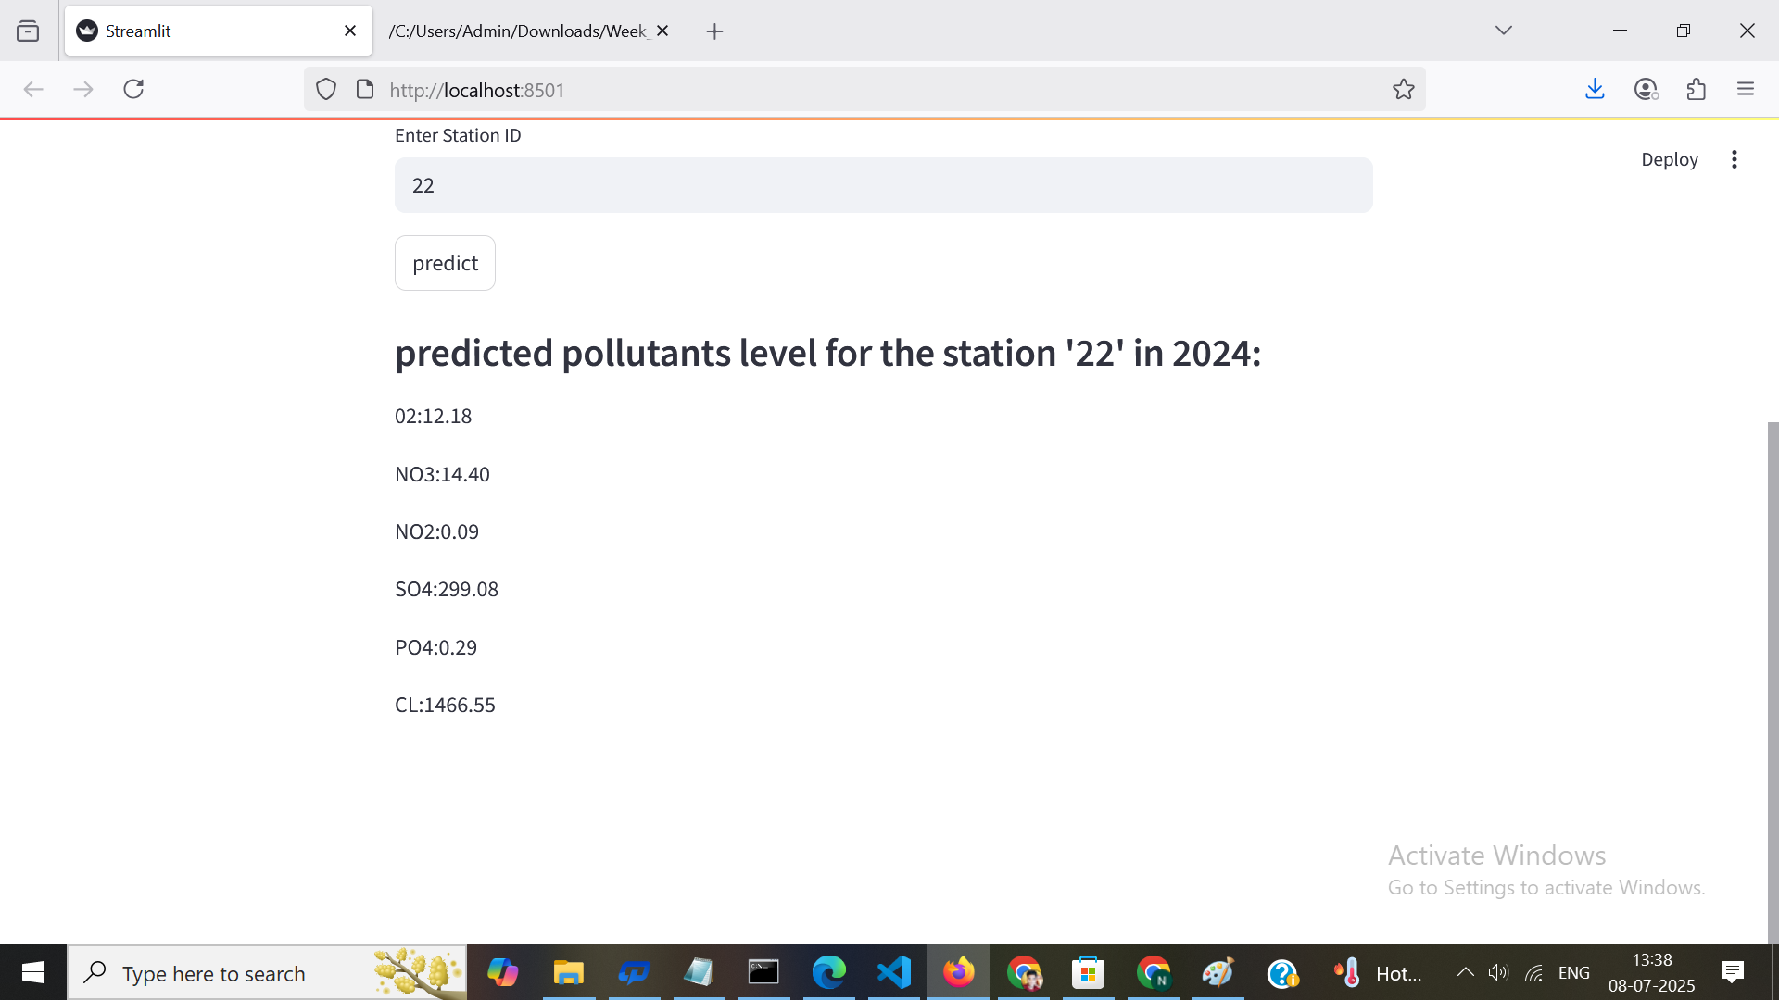
Screenshot of Output:

Slide 8
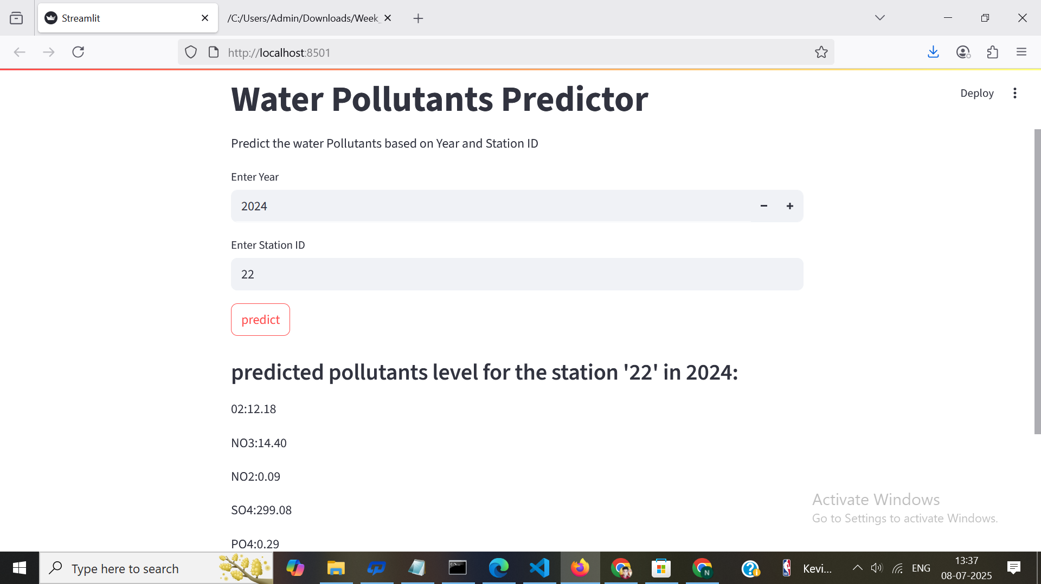
Screenshot of Output:

Slide 9
Conclusion:
Water prediction is a critical tool for managing water resources effectively in the face of growing demand and climate variability. By accurately forecasting rainfall, river flows, and groundwater levels, we can better plan for agriculture, prevent floods and droughts, and ensure water for future generations.

